Slide 1
Update on Bachelor Thesis
23.09.2024

Slide 2
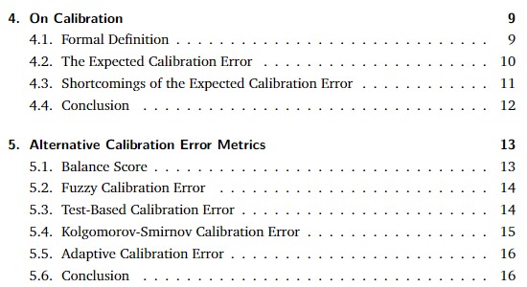
Written Thesis
Introductory Chapter
Concepts Chapter:
Calibration
True Expected Calibration Error
ECE
all alternative Metrics
https://www.overleaf.com/read/hzhhzvtfkmkz#ca9a3b

Slide 3
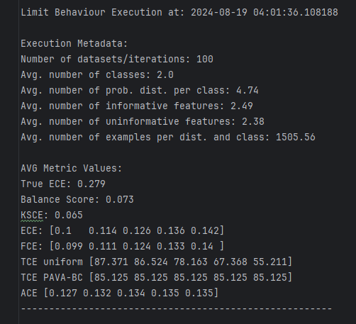
Code Base
Exhaustive Calculation
Qualitative Analysis:
Mean Deviation
Variance Deviation
Sine (Phase Shift)

Slide 4
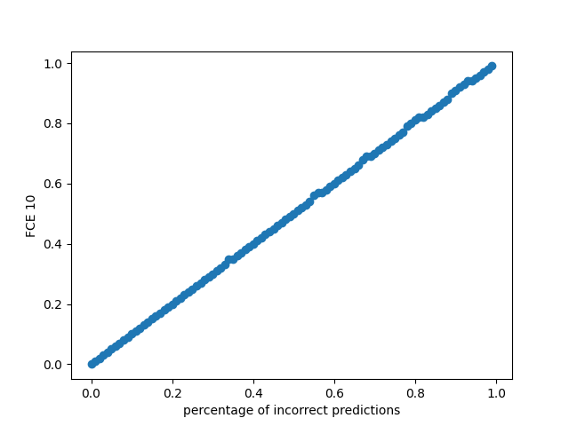
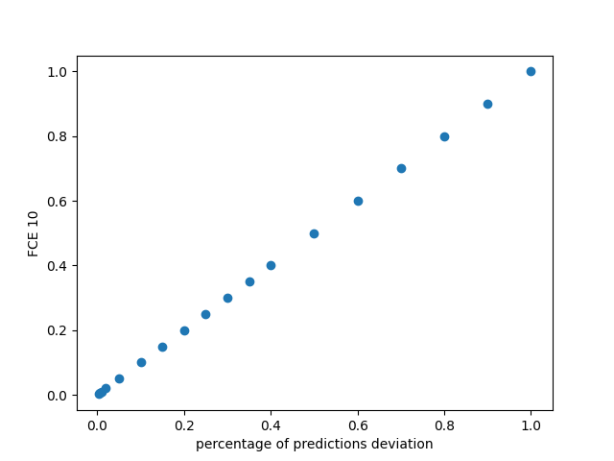
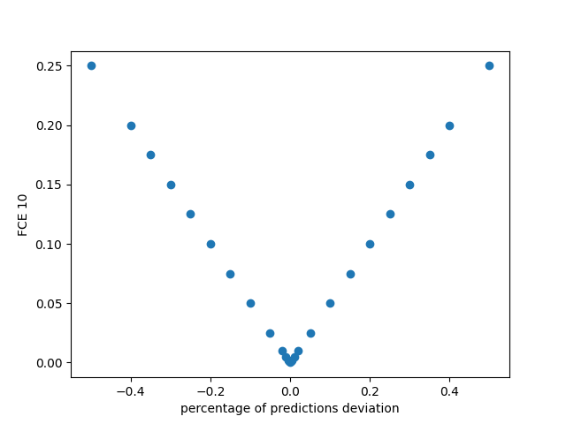
Exemplary Plots of Qualitative Analysis
Varying percentage of incorrect predictions
Varying percentage of prediction deviation
Investigating symmetry when varying percentage of prediction deviation from 50% initial probability

Slide 5
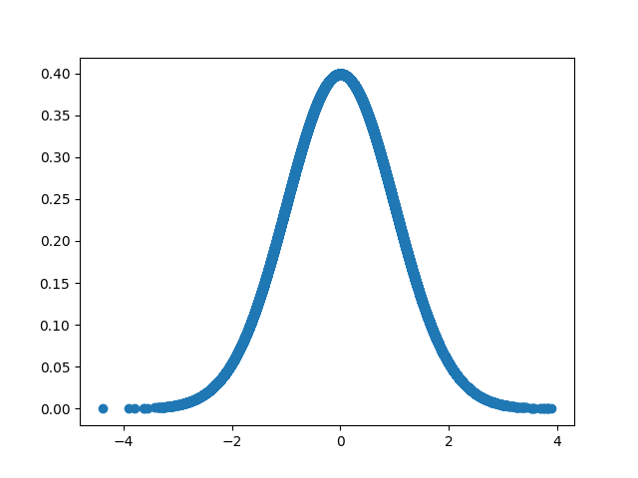
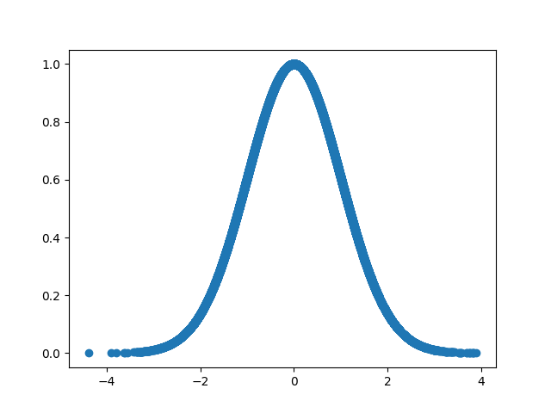
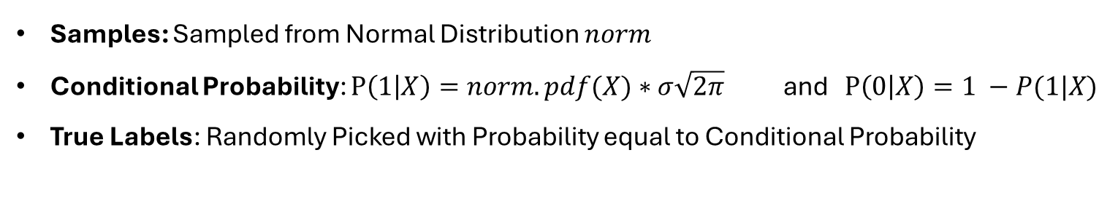

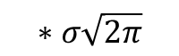
Setup
Qualitative Analysis
Samples: Sampled from Normal Distribution $norm$
Conditional Probability: $P\left(1 | X\right)=norm.pdf(X)∗σ\sqrt{2π}$ and $P\left(0 | X\right)=1 −P(1|X)$
True Labels: Randomly Picked with Probability equal to Conditional Probability
Normal Distribution $norm$
Conditional Probabilities for Class Label 1
$$∗σ\sqrt{2π}$$

Slide 6
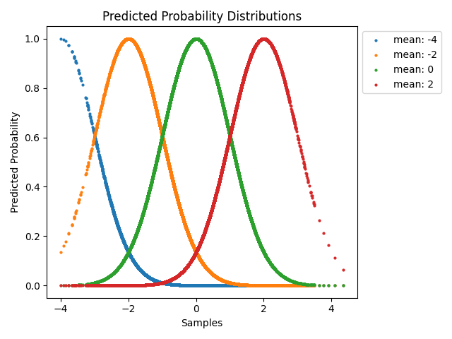
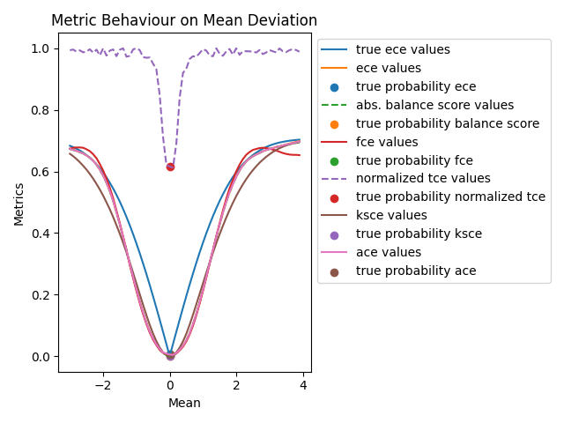
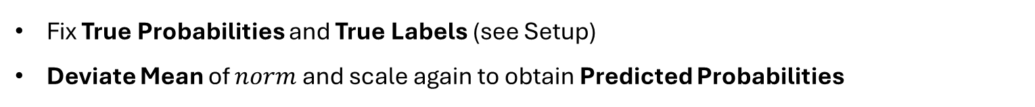
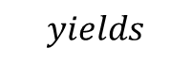
Mean Deviation
Qualitative Analysis
Fix True Probabilities and True Labels (see Setup)
Deviate Mean of $norm$ and scale again to obtain Predicted Probabilities
$$yields$$
sample size: 40000

Slide 7
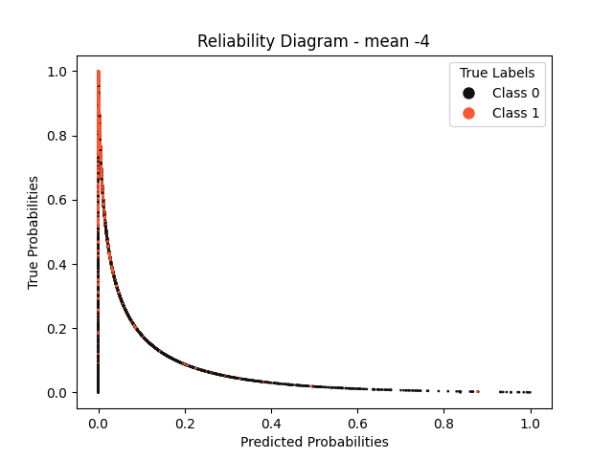
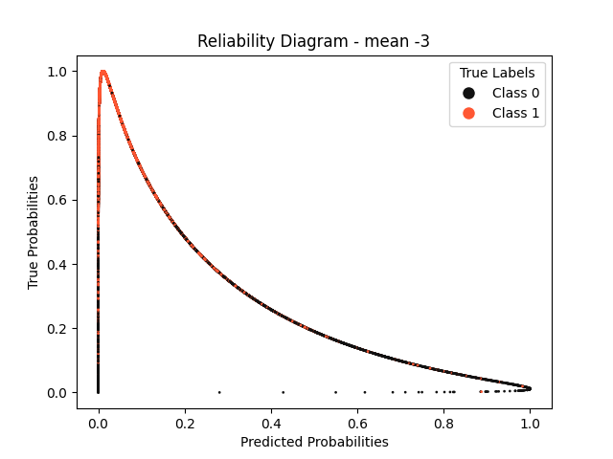
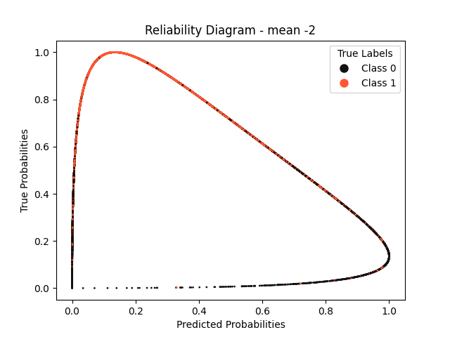
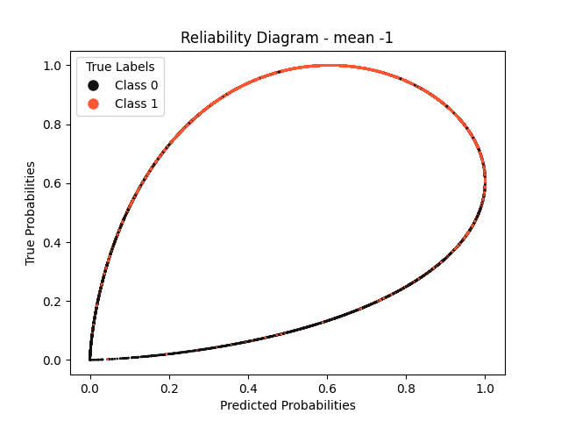
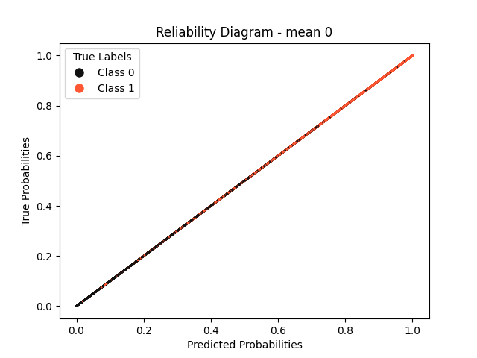
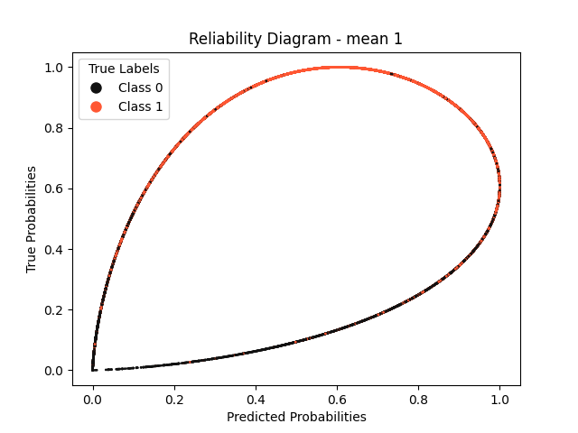
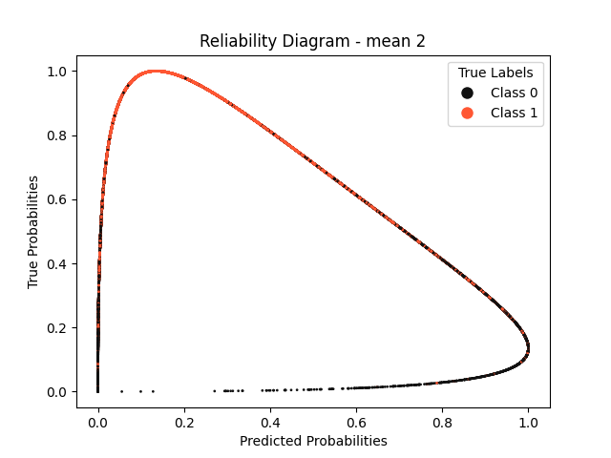

Reliability Diagrams – Mean Deviation

Slide 8
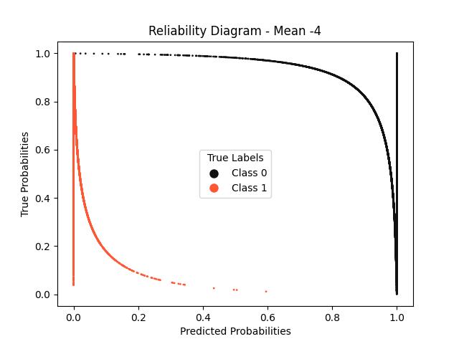
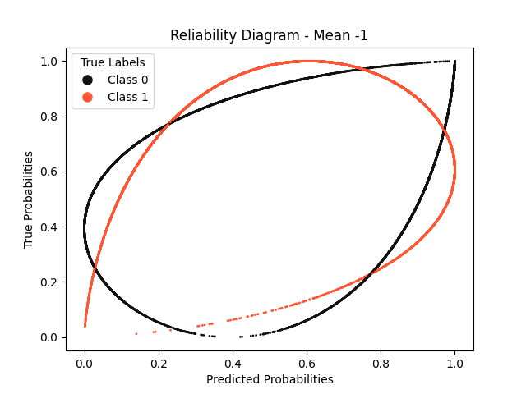
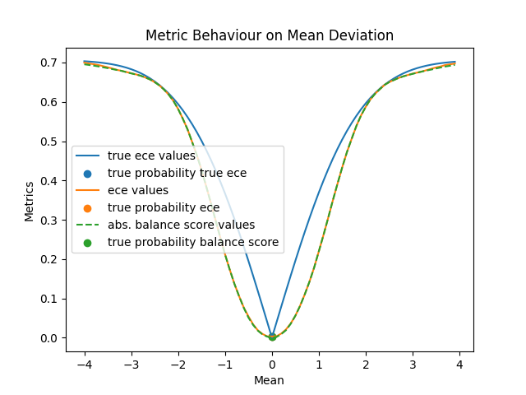
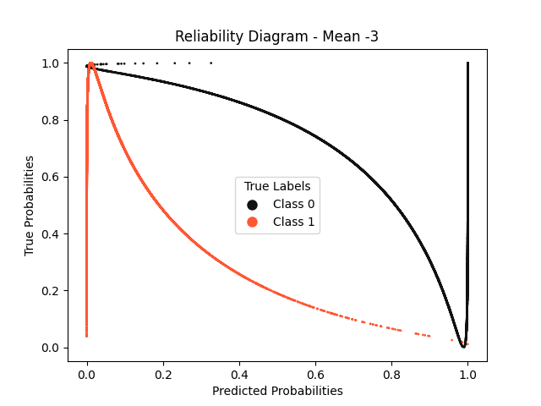
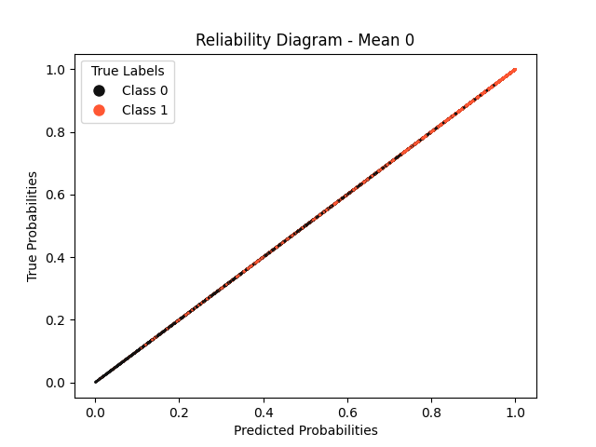
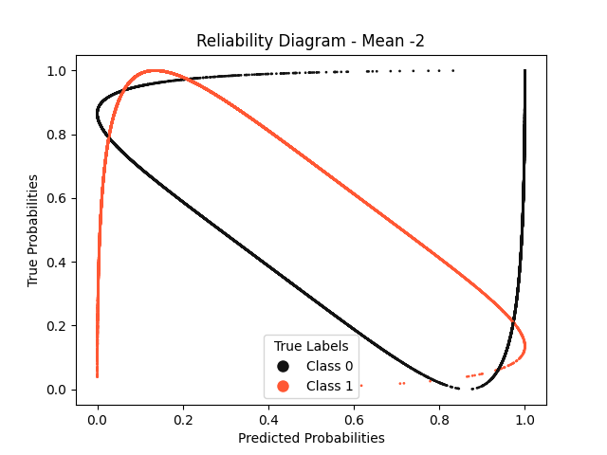


Slide 9
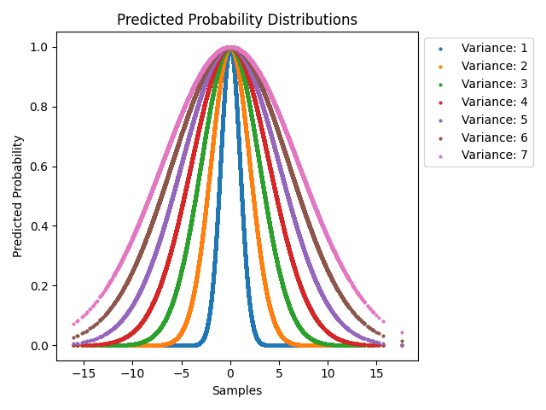
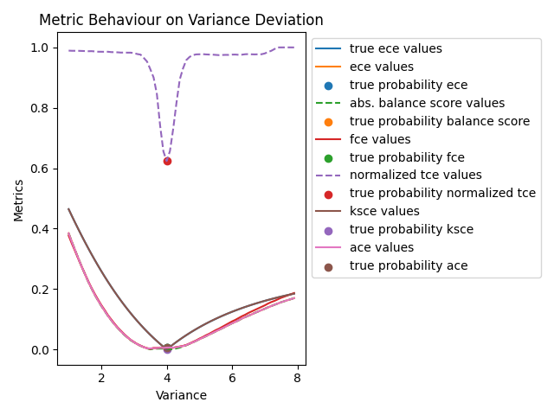
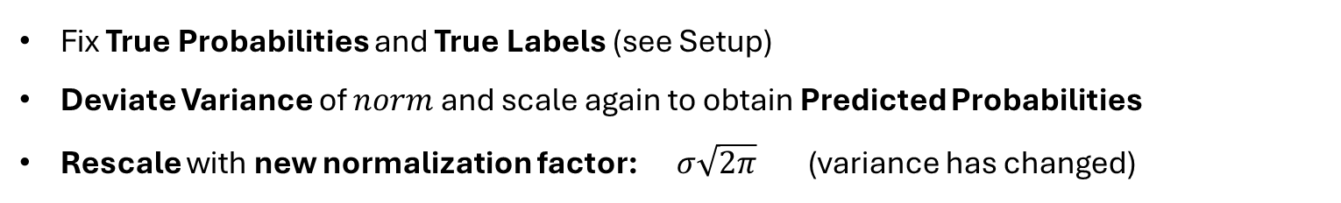
Variance Deviation (Dynamic Rescaling)
Qualitative Analysis
Fix True Probabilities and True Labels (see Setup)
Deviate Variance of $norm$ and scale again to obtain Predicted Probabilities
Rescale with new normalization factor: $σ\sqrt{2π}$ (variance has changed)
$$yields$$
sample size: 40000

Slide 10
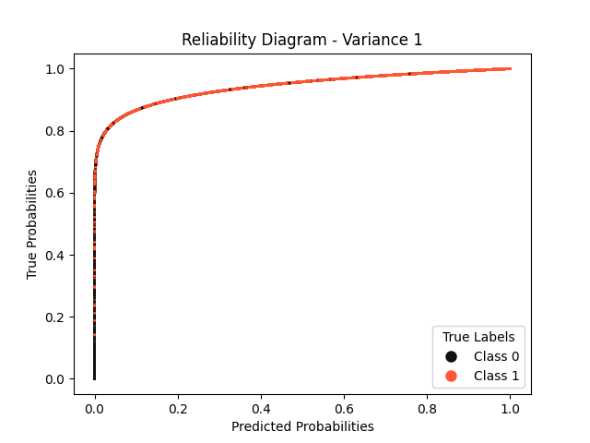
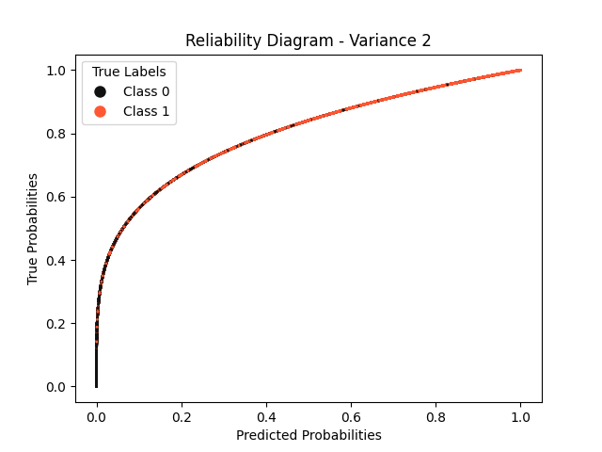
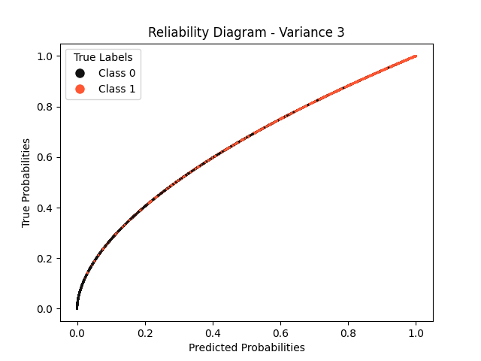
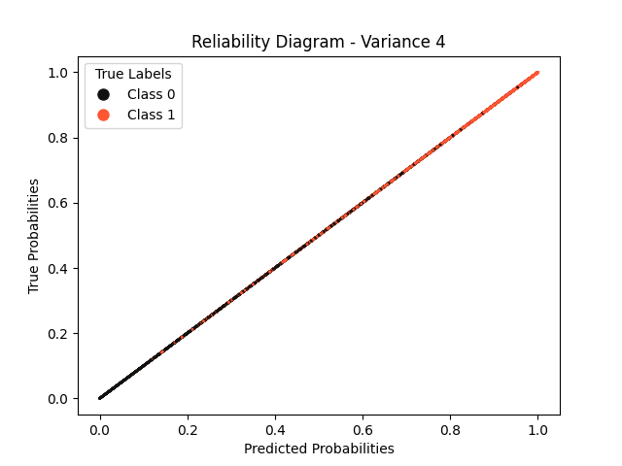
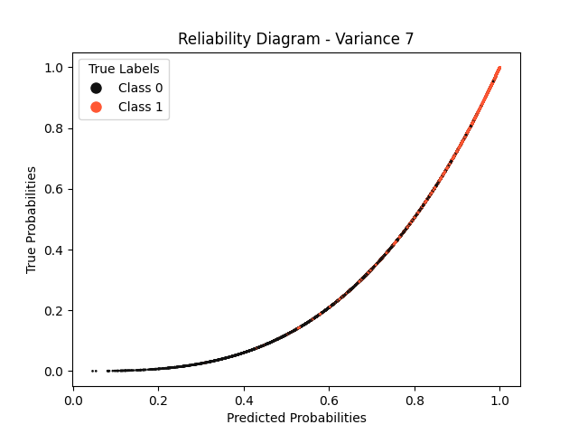
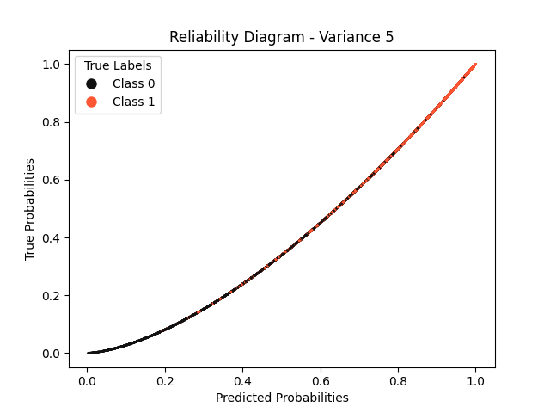
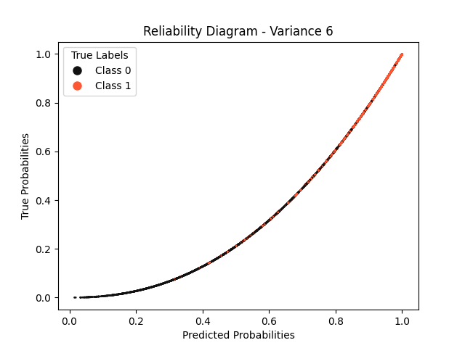
Reliability Diagrams – Variance Deviation (Dynamic Rescaling)

Slide 11
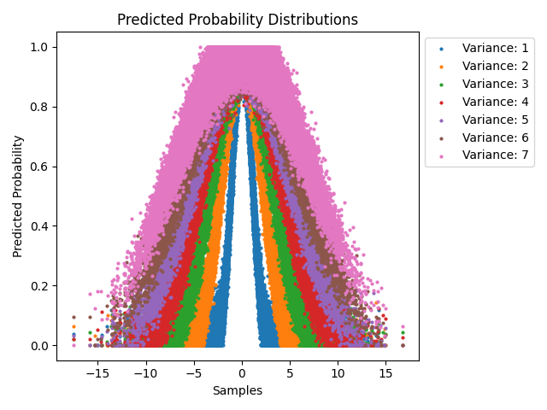
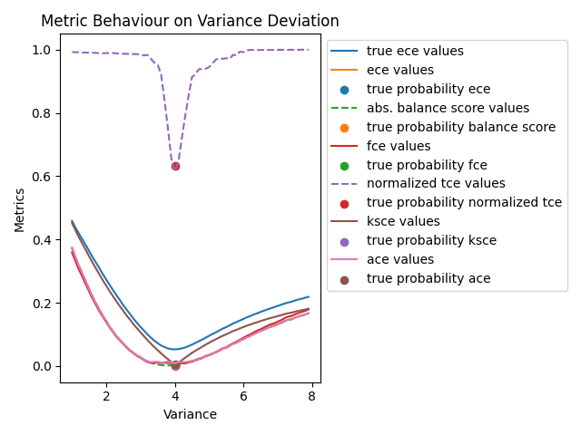
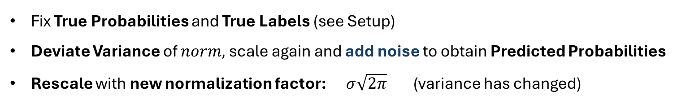
Variance Deviation (Dynamic Rescaling) with Noise
Qualitative Analysis
Fix True Probabilities and True Labels (see Setup)
Deviate Variance of $norm,$scale again and add noise to obtain Predicted Probabilities
Rescale with new normalization factor: $σ\sqrt{2π}$ (variance has changed)
$$yields$$
sample size: 40000; noise: random gaussian (mean=0, variance = 0.05)

Slide 12
Variance Deviation (Dynamic Rescaling) with Noise
Qualitative Analysis

Slide 13
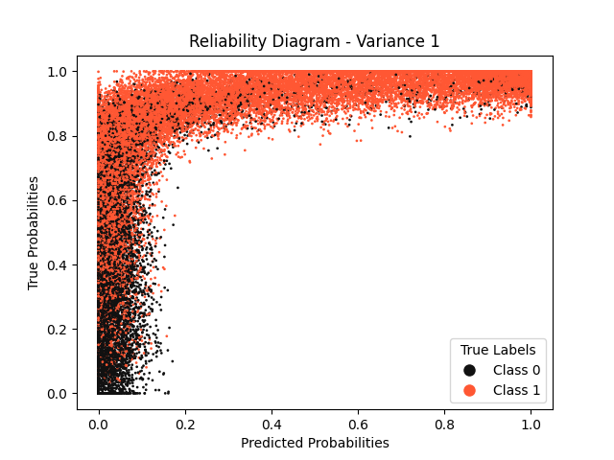
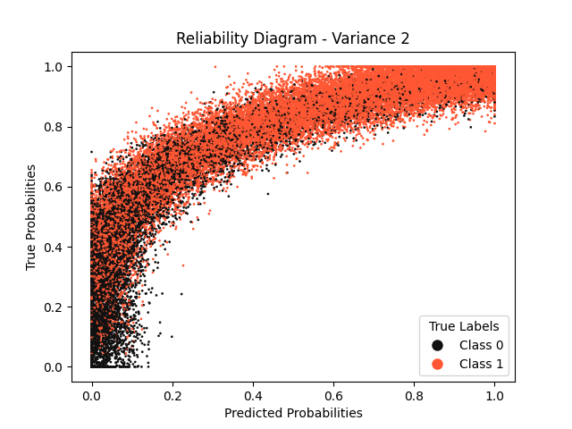
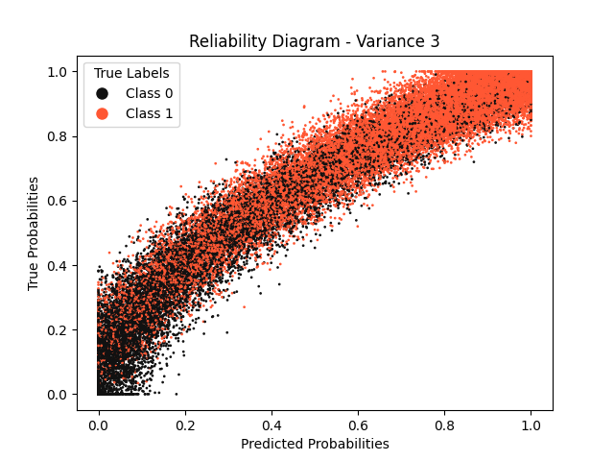
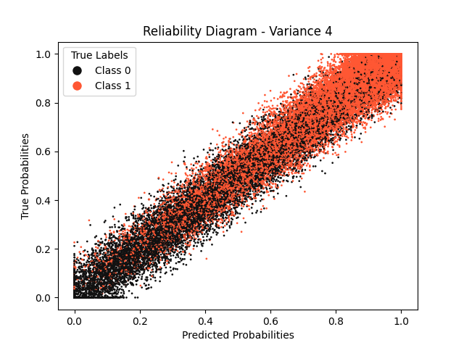
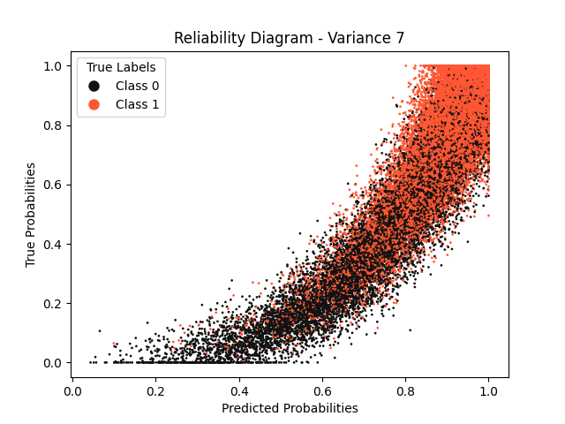
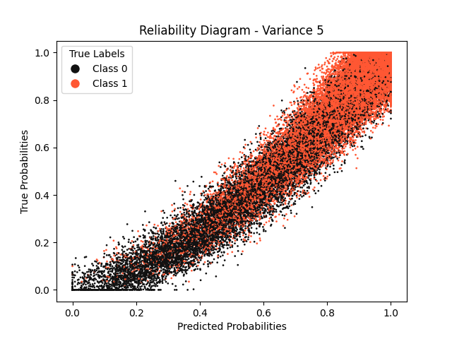
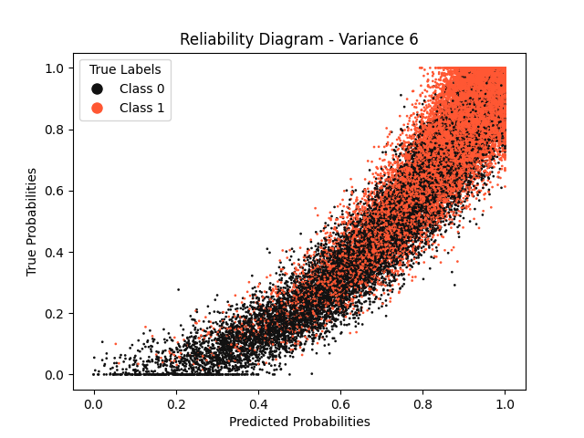
Reliability Diagrams – Variance Deviation (Dynamic Rescaling)
noise: random gaussian (mean=0, variance = 0.05)

Slide 14
Comparison without Noise - with Noise
Qualitative Analysis
Without Noise
With Noise
sample size: 40000; noise: random gaussian (mean=0, variance = 0.05)

Slide 15
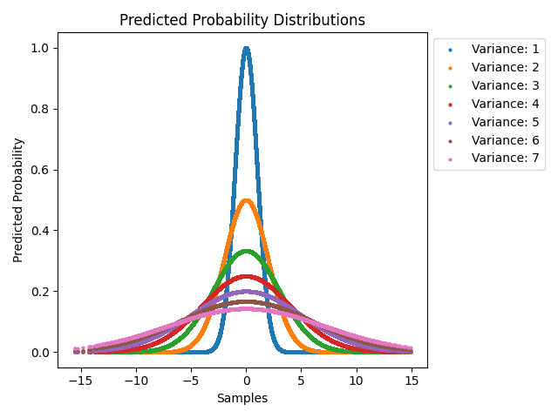
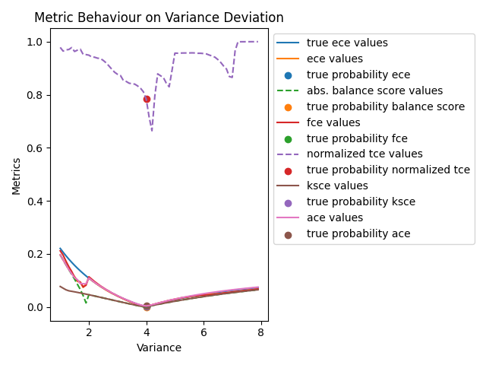
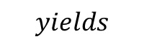
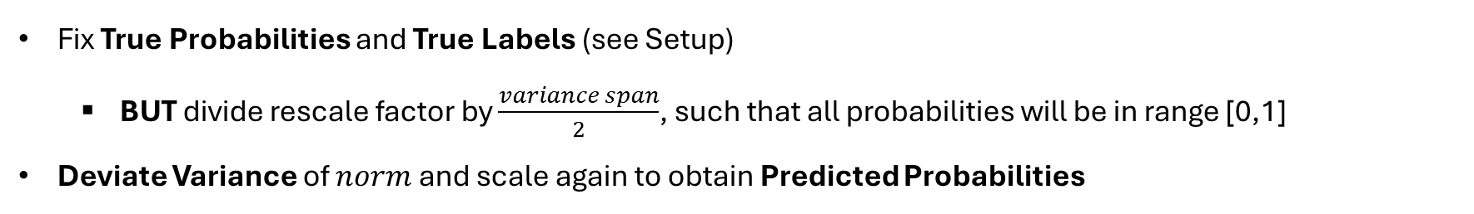
Variance Deviation (Static Rescaling)
Qualitative Analysis
Fix True Probabilities and True Labels (see Setup)
BUT divide rescale factor by $\frac{variance span}{2}$, such that all probabilities will be in range [0,1]
Deviate Variance of $norm$ and scale again to obtain Predicted Probabilities
$$yields$$
sample size: 40000

Slide 16







Reliability Diagrams – Variance Deviation (Static Rescaling)

Slide 17



Sine (Phase Shift)
Qualitative Analysis
Fix True Probabilities and True Labels (see Setup)
BUT replace $norm$with normalized sine wave: $\frac{1}{2}(\sin\left(x\right)+1)$ AND sample from uniform dist.
Deviate Sine Argument by adding a scalar value to $x$ to obtain Predicted Probabilities
$$yields$$
sample size: 40000; sample range: $[−π, π]$

Slide 18


Slide 19


Sample size: 100
Sample size: 1000

Slide 20





sample size: 40000; noise: gaussian;

Slide 21







Reliability Diagrams – Sine (Phase Shift)

Slide 22




Why is TCE so high?
Qualitative Analysis
Excerpt from Original Paper
Excerpt from Original Paper

Slide 23
Variance Deviation (Dynamic Rescaling) – Reduced Sample Size
Sample size: 100
Sample size: 1000

Slide 24



Noise Increase
Qualitative Analysis
Fix True Probabilities and True Labels (see Setup)
Add modified gaussian noise: $p=norm\left(0, step\right)∗{\left(p_{true}+0.1\right)\left(1.1 −p_{true}\right)}^{1.5} ∗10$
Clip to range [0,1]
$$yields$$
sample size: 40000
Notes:
Scaling by 10 is necessary to keep the noise effectively the same as „step“ +0.1 and 1.1 (instead of 1.0 adds base noise for probs exactly 0 and exactly 1)

Slide 25







Reliability Diagrams – Noise Increase

Slide 26





Case Simulation – Random Forest
$p=norm\left(0, 0.07\right)∗{\left(p_{true}+0.05\right)\left(1.05 −p_{true}\right)}^{1.5} ∗10$
clip to range [0,1]
$p=norm\left(0, 0.06\right)∗{\left(p_{true}+0.05\right)\left(1.05 −p_{true}\right)}^{1.5} ∗10$
clip to range [0,1.25] multiply by 0.8
sample size: 2000

Slide 27






Case Simulation – Support Vector Machine
$noise←norm\left(0, 0.02\right)∗{\left(p_{true}+0.1\right)\left(1.1 −p_{true}\right)}^{1.5} ∗10$
$p←\frac{1}{2^{1.1}} {\left(\sin\left(π∗p −1.5\right)+1\right)}^{1.1}$
$p←p ∗0.8+0.1+noise$
$noise←norm\left(0, 0.04\right)∗{\left(p_{true}+0.1\right)\left(1.1 −p_{true}\right)}^{1.5} ∗10$
$p←\frac{1}{2^{1.1}} {\left(\sin\left(π∗p+1.5\right)+1\right)}^{1.1}$
$p←p ∗0.8+0.1+noise$
clip to range [0,1.25]
multiply by 0.8
sample size: 2000

Slide 28






Case Simulation – Logistic Regression
$noise←norm\left(0, 0.01\right) ∗abs\left(p_{true}−0.5\right)∗4$
$p←p +noise$
clip to range [0,1.25]
$noise←abs(norm\left(0, 0.09\right))∗{\left(p_{true}+0.1\right)\left(1.1 −p_{true}\right)}^{1.5} ∗10$
$p←2 ∗{\left(1.1 ∗p_{true} −0.36\right)}^{3}+0.2$
$p←p ∗0.8+0.1+noise$
clip to range [0,1]
multiply by 0.8
sample size: 2000

Slide 29


Case Simulation – Neural Network
X_train, X_test, y_train, y_test = train_test_split(samples, labels, test_size=.2)
model = tf.keras.Sequential()
model.add(tf.keras.layers.Dense(50, activation="tanh"))
model.add(tf.keras.layers.Dense(2,activation="softmax"))
model.compile(optimizer="rmsprop", loss="categorical_crossentropy", metrics=["accuracy"])
model.fit(X_train.reshape(-1, 2), y_train, epochs=15, batch_size=1000)
sample size: 40000

Slide 30
Metric Evaluation – Case Simulation
Metrics | Random Forest 1 | Random Forest 2 | SVM 1 | SVM 2 | Logistic Regression 1 | Logistic Regression 2 | Neural Network
True ECE | 0.0485 | 0.033 | 0.048 | 0.0508 | 0.009 | 0.1105 | 0.0514
ECE (15) | 0.0259 | 0.011 | 0.0406 | 0.0188 | 0.0135 | 0.0246 | 0.022
Balance Score (abs.) | 0.0176 | 0.011 | 0.006 | 0.0096 | 0.0021 | 0.0224 | 0.022
FCE (15) | 0.026 | 0.011 | 0.041 | 0.019 | 0.014 | 0.025 | 0.026
TCE (15, norm.) | 0.4013 | 0.1995 | 0.577 | 0.3375 | 0.2748 | 0.6975 | 0.61
KSCE | 0.01474 | 0.0112 | 0.012 | 0.0231 | 0.0053 | 0.0747 | 0.021
ACE (15) | 0.0251 | 0.0228 | 0.043 | 0.0213 | 0.0161 | 0.035 | 0.022
Italic : True ECE Bold : Closest to True ECE Underlined : Second Closest to True ECE Sample Size: 4000

Slide 32



Variance Deviation (Dynamic Rescaling) with Noise, Isotonic Regression
Qualitative Analysis
Fix True Probabilities and True Labels (see Setup)
Deviate Variance of $norm,$rescale and add noise & Isotonic Regression to obtain Predicted Probabilities
Rescale with new normalization factor: $σ\sqrt{2π}$ (variance has changed)
$$yields$$
sample size: 40000; noise: random gaussian (mean=0, variance = 0.05)

Slide 33







Reliability Diagrams – Variance Deviation (Dynamic Rescaling) with Noise and Isotonic Regression
noise: random gaussian (mean=0, variance = 0.05)

Slide 34

Grid Search SVM
sample size: 8400

Slide 35






Reliability Diagrams – Grid Search: SVM with RBF Kernel
C: 0.1
C: 1
C: 10
Gamma: scale
Gamma: auto
sample size: 8400

Slide 36






Reliability Diagrams – Grid Search: SVM with Linear Kernel
C: 0.1
C: 1
C: 10
Gamma: scale
Gamma: auto
sample size: 8400

Slide 37






Reliability Diagrams – Grid Search: SVM with Sigmoid Kernel
C: 0.1
C: 1
C: 10
Gamma: scale
Gamma: auto
sample size: 8400

Slide 38



SVM Interpolation
Qualitative Analysis
Fix True Probabilities and True Labels (see Setup)
Transform with Sigmoid Function & add Modified Gaussian Noise to obtain Predicted Probabilities $p ←1 / (1 +exp⁡(− step (p − 0.5))$
$$yields$$
sample size: 40000; noise: modified gaussian (step=0.015)

Slide 39









Reliability Diagrams – SVM Interpolation

Slide 40
Varying Sample Size
Experiments
Fix Dataset
Train Models (on training set):
Neural Network
SVM
Logistic Regression
Random Forest
Evaluate Metrics n times (on different subsamples of same size of the test set)
Calculate Mean and Standard Deviation
Repeat 3. and 4. for all subsample sizes

Slide 41

Experiments
The Gummy Worm Dataset

Slide 42






Datasets – Varying Sample Size
Samples: 100
Samples: 1000
Samples: 5000
Samples: 10.000
Samples: 40.000
Samples: 80.000
sample size: 8400

Slide 43






Evaluation – Varying Sample Size
Samples: 100
Samples: 1000
Samples: 5000
Samples: 10.000
Samples: 40.000
Samples: 80.000
Seems to highly depend on how good a model is??

Slide 44






Evaluation – Varying Sample Size (SVM Kernel: rbf instead of linear)
Samples: 100
Samples: 1000
Samples: 5000
Samples: 10.000
Samples: 40.000
Samples: 80.000

Slide 45
New Idea – Varying Sample Size
Use Grid Search to find good or optimal Model beforehand?
Then only use the good Models?

Slide 46




Evaluation – Varying Sample Size on SVM – Iterations: 20

Slide 47

Evaluation – Varying Sample Size on SVM – Iterations: 20
Training sample size: 50000, Replace: True

Slide 48

Evaluation – Varying Sample Size on Neural Network – Iterations: 20
Training sample size: 50000, Replace: True

Slide 49

Evaluation – Varying Sample Size on LR – Iterations: 20
Training sample size: 50000, Replace: True

Slide 50
Evaluation – Varying Sample Size on Random Forest – Iterations: 20
Loading…
Training sample size: 50000, Replace: True

Slide 51
Grid Search
Experiments
Fix Dataset
Perform Grid Search
Neural Network
SVM
Logistic Regression
Random Forest
Calculate Metrics
Rank Estimators by Accuracy and True ECE

Slide 52


Evaluation – Grid Search – SVM – 5 Folds – Sorted by Accuracy
Absolute Values
Relative Values

Slide 53


Evaluation – Grid Search – SVM – 5 Folds – Sorted by True ECE
Absolute Values
Relative Values

Slide 54


Evaluation – Grid Search – NN – 5 Folds – Sorted by Accuracy
Absolute Values
Relative Values

Slide 55


Evaluation – Grid Search – NN – 5 Folds – Sorted by True ECE
Absolute Values
Relative Values

Slide 56


Evaluation – Grid Search – LR – 5 Folds – Sorted by Accuracy
Absolute Values
Relative Values

Slide 57


Evaluation – Grid Search – LR – 5 Folds – Sorted by True ECE
Absolute Values
Relative Values

Slide 58


Evaluation – Grid Search – RF – 5 Folds – Sorted by Accuracy
Absolute Values
Relative Values

Slide 59


Evaluation – Grid Search – RF – 5 Folds – Sorted by True ECE
Absolute Values
Relative Values

Slide 60



Evaluation – Varying Sample Size on SVM – Iterations: 20

Slide 61


Slide 62






True ECE Calculation (probably erroneous)
Mean of absolute distance between unique predicted probabilities (for class 1) and mean of corresponding true probabilities
$$\hat{p}$$
$$p_{true}$$
$$\left|0.8 −\frac{0.7+0.6+0.5}{3}\right|=0.2$$
0.8
0.7
0.8
0.6
$$\left|0.6 −\frac{0.55+0.7}{2}\right|=0.025$$
0.6
0.55
0.8
0.5
$$⇒True ECE=\frac{0.2+0.025}{2}=0.1125$$
0.6
0.7

Slide 63
Metric Bounds
Balance Score: [-1, 0.5] (per Definition)
ECE: [0, 1] (Extreme Cases: 1 Bin)
ACE: [0, 1] (Extreme Cases: 1 Bin) (the same as ECE)
FCE: [0, 1] (Extreme Cases: 1 Bin) (the same as ECE)
TCE: [0, 100] (Stated in the Paper)
KSCE: [0, 1] (Calculates max difference between Accuracy CDF and Confidence CDF) (Extreme Cases: Outcome always 1 and Prediction 0% or Outcome always 0 and Prediction 100%)

Slide 64
Scaling Solution
Balance Score: [-1, 0.5] -> [0, 1] by absolute value
ECE: [0, 1] stay as is
ACE: [0, 1] stay as is
FCE: [0, 1] stay as is
TCE: [0, 100] -> [0, 1] by dividing by 100
KSCE: [0, 1] stay as is

Slide 65
What is new?
+ 3 Datasets
+ 1 Experiment

Slide 66
Varying Bins
Experiments
Fix Dataset
Train Models (on training set):
Neural Network
SVM
Logistic Regression
Random Forest
Evaluate Metrics n times (with the same number of bins on different subsamples of the same size)
Calculate Mean and Standard Deviation
Repeat 3. and 4. for every number of bins

Slide 67




Evaluation – Varying Bins, 20 Iterations

Slide 68




Datasets
Balanced
Imbalanced
 | 2-D (Gummy Worm) | 3-D (Sad Clown)

Slide 69
Balanced | SVM | Neural Network | SVM | Neural Network
 | Logistic Regression | Random Forest | Logistic Regression | Random Forest
Imbalanced | SVM | Neural Network | SVM | Neural Network
 | Logistic Regression | Random Forest | Logistic Regression | Random Forest
 | 2-D (Gummy Worm) |  | 3-D (Sad Clown)

Slide 70
Corrected True ECE Calculation – Varying Test Sample Size
true_ece_samples = sample_uniformly_within_bounds(p1=[0, -3], p2=[15, 15], size=200000)
# Get predictions and true probabilities
predictions = model.predict_proba(true_ece_samples) true_probabilities = data_generation.get_conditional_probabilities(samples=true_ece_samples)
true_ece_val = true_ece_binned(predictions, true_probabilities, bin_bounds=np.linspace(0, 1, 100))
def true_ece_binned(scores, true_prob, bin_boundaries) :
bin_lowers = bin_boundaries[:-1]
bin_uppers = bin_boundaries[1:]
scores = scores[:, 1]
true_prob = true_prob[:, 1]
calibration_error = 0.0
for bin_lower, bin_upper in zip(bin_lowers, bin_uppers):
samples_in_bin = (scores > bin_lower) & (scores <= bin_upper)
relative_samples_in_bin = samples_in_bin.mean()
if relative_samples_in_bin > 0:
true_prob_in_bin = true_prob[samples_in_bin].mean()
avg_confidence_in_bin = scores[samples_in_bin].mean()
calibration_error += np.abs(avg_confidence_in_bin - true_prob_in_bin) * relative_samples_in_bin
return calibration_error

Slide 71
Corrected True ECE Calculation – Varying Test Sample Size

Slide 72





Corrected True ECE Calculation – Varying Test Sample Size

Slide 73

Corrected True ECE Calculation – Varying Test Sample Size - SVM
True
Predicted
Difference

Slide 74


Corrected True ECE Calculation – Varying Test Sample Size
Old
New

Slide 75


Corrected True ECE Calculation – Varying Test Sample Size – NN
True
Predicted
Difference

Slide 76


Corrected True ECE Calculation – Varying Test Sample Size
Old
New

Slide 77


Corrected True ECE Calculation – Varying Test Sample Size – LR
True
Predicted
Difference

Slide 78


Corrected True ECE Calculation – Varying Test Sample Size
Old
New

Slide 79


Corrected True ECE Calculation – Varying Test Sample Size – RF
True
Predicted
Difference

Slide 80


Corrected True ECE Calculation – Varying Test Sample Size - RF
Old
New

Slide 81

Corrected True ECE Calculation – Varying Test Sample Size
New

Slide 82
06.03.25

Slide 83


Corrected True ECE Calculation – Varying Test Sample Size – SVM
True
Predicted
Difference

Slide 84



Corrected True ECE Calculation – Varying Test Sample Size – SVM
True
Predicted
Difference

Slide 85


Corrected True ECE Calculation – Varying Test Sample Size – SVM

Slide 86

Corrected True ECE Calculation – Varying Test Sample Size – SVM

Slide 87


Corrected True ECE Calculation – Varying Test Sample Size – NN
True
Predicted
Difference

Slide 88


Corrected True ECE Calculation – Varying Test Sample Size – NN
True
Predicted
Difference

Slide 89


Corrected True ECE Calculation – Varying Test Sample Size - NN

Slide 90

Corrected True ECE Calculation – Varying Test Sample Size - NN

Slide 91


Corrected True ECE Calculation – Varying Test Sample Size – LR
True
Predicted
Difference

Slide 92


Corrected True ECE Calculation – Varying Test Sample Size – LR
True
Predicted
Difference

Slide 93


Corrected True ECE Calculation – Varying Test Sample Size – LR

Slide 94

Corrected True ECE Calculation – Varying Test Sample Size - LR

Slide 95


Corrected True ECE Calculation – Varying Test Sample Size – RF
True
Predicted
Difference

Slide 96


Corrected True ECE Calculation – Varying Test Sample Size – RF
True
Predicted
Difference

Slide 97


Corrected True ECE Calculation – Varying Test Sample Size - RF

Slide 98

Corrected True ECE Calculation – Varying Test Sample Size - RF

Slide 99
Varying Test Sample Size on Dataset Families
Idea:
Do not average over 20 subsamples of the same size
Instead do average over a dataset family consisting of 20 datasets

Slide 100
Varying Test Sample Size on Dataset Families
20 datasets
20 training sets
20 test sets
Gummy Worm Family →
(altered means, cov. and loc. of Gummy Worm Dataset Distributions)

Slide 101




















original

Slide 102


Varying Test Sample Size on Gummy Worm Familiy - SVM

Slide 103

Varying Test Sample Size on Gummy Worm Familiy - SVM

Slide 104


Varying Test Sample Size on Gummy Worm Familiy - NN

Slide 105

Varying Test Sample Size on Gummy Worm Familiy - NN

Slide 106


Varying Test Sample Size on Gummy Worm Familiy - LR

Slide 107

Varying Test Sample Size on Gummy Worm Familiy - LR

Slide 108
Lin. Sep.
Lin. Sep.
Lin. Sep.
Lin. Sep.
Lin. Sep.

Slide 109


Varying Test Sample Size on Gummy Worm Familiy - RF

Slide 110

Varying Test Sample Size on Gummy Worm Familiy - RF

Slide 111




Bin Count True ECE - Gummy Worm Dataset - SVM

Slide 112




Bin Count True ECE - Gummy Worm Dataset - NN

Slide 113




Bin Count True ECE - Gummy Worm Dataset - LR

Slide 114




Bin Count True ECE - Gummy Worm Dataset - RF

Slide 115


Varying Test Sample Size with diff. Train-Test-Splits - SVM

Slide 116

Varying Test Sample Size with diff. Train-Test-Splits - SVM

Slide 117

Varying Test Sample Size with diff. Train-Test-Splits - SVM

Slide 118


Varying Test Sample Size with diff. Train-Test-Splits - NN

Slide 119

Varying Test Sample Size with diff. Train-Test-Splits - NN

Slide 120


Varying Test Sample Size with diff. Train-Test-Splits - LR

Slide 121

Varying Test Sample Size with diff. Train-Test-Splits - LR

Slide 122


Varying Test Sample Size with diff. Train-Test-Splits - RF

Slide 123

Varying Test Sample Size with diff. Train-Test-Splits - RF

Slide 124
Update 14.04.25
What worked:
Implementing Accuracy Rejection Curves (ARC)
Finding a Dataset which fills True ECE bins more equally/more at the center
What I still struggle with:
Finding a way for determining optimal/very good sample size for ece calculation

Slide 125

Accuracy Rejection Curve (ARC)
Parameters
SVM (RBF)
Gummy Worm Dataset (40000 ex.)
Test Set Size: 8000
Rejection Steps: 100
Strategy: (Shannon) Entropy
True ECE (Dists – 100 Bins): 0.01093

Slide 126


Exclamation Mark Dataset

Slide 127






True ECE Bin Count on Exclamation Mark Dataset - SVM

Slide 128






True ECE Bin Count on Exclamation Mark Dataset - NN

Slide 129






True ECE Bin Count on Exclamation Mark Dataset - LR

Slide 130






True ECE Bin Count on Exclamation Mark Dataset - RF

Slide 131




Primitive Optimal True ECE assessment (no averaging)

Slide 132


Varying Test Sample Size with Dataset Family- NN
Exclamation Mark Dataset
Gummy Worm Dataset
More or less the same plots... (similar for train test split variation)

Slide 133


Varying Test Sample Size with diff. Train-Test-Splits - NN
Exclamation Mark Dataset
Gummy Worm Dataset
More or less the same trend... (similar for train test split variation)

Slide 134

Optimal Sample Size for ECE assessment
First Idea: Algorithmic
Looking at the plots of Varying Test Sample Size Experiments
Three features seem to have influence:
Relative ECE Falloff
Accuracy
First Plateau Sample Size
Relative ECE Falloff
First Plateau Sample Size

Slide 135
Optimal Sample Size for ECE assessment
How the algorithm works:
Find first plateau given two parameters: threshold, number of steps
Calculate Relative ECE Falloff
Determine some factor in range [0, 1] based on Relative ECE Falloff, First Plateau Sample Size and Accuracy
Determine sample size between minimum sample size and sample size at the beginning of the first plateau by scaling difference by the aforementioned factor

Slide 136

Optimal Sample Size for ECE assessment
Current attempt on capturing the relationship:

Slide 137
Optimal Sample Size for ECE assessment
Sometimes it works well...

Slide 138

Optimal Sample Size for ECE assessment
...sometimes it does not.

Slide 139

Optimal Sample Size for ECE assessment

Slide 140

True E

Slide 141
Optimal Sample Size for ECE assessment
Only advantage over 20% train test split (5000 samples):
Mean of sample size: 3444.875 (opposed to 5000)
However: Std. Dev. of sample size: 2260.3617 (opposed to 0)
For comparison:
Mean of sample size (ECE Optimal): 6280.9713
Std. Dev. of sample size (ECE Optimal): 6595.5707

Slide 142
Optimal Sample Size for ECE assessment
Questions:
Stick to algorithmic approach? Seems to be essentially charting – does not seem to generalize well (also probably proof – or at least good evidence needed that it converges)
Rather prosecute ML approach? How much data do I need? What model? Maybe Set Transformer?
What True ECE to choose as a “ground truth”? Sometimes ECE crosses Grid- not Dists-True-ECE’s (Maybe choose closest of all four?)
5000 examples seems to do well – maybe already the answer?
Addon: EM algorithm to provide good evidence that data generation works?

Slide 143
ML Approach for Optimal ECE assessment

Slide 144

Gathering Data
Use your SyntheticDataGenerator
Train SVM, NN, LR, RF
Calculate ECE for test sample size up to 10000 (100 samples per step)
Retrieve about 17000 datapoints

Slide 145
Problem Statement
X
Y
Model
0.256
0.143
0.089
…
0.032
0.0321
Calculation
ECE values
612
0.045
Optimal Sample Size
Optimal ECE

Slide 146
Models
Neural Network (with Bayesian Optimization)
XGBRegressor
„pure strategies“ (i.e. always using the same sample size)

Slide 147
Results
Strategy | Mean (Samples) | Std. Dev. (Samples) | MSE (Samples) | MAE (Samples) | R2-Score (Samples)
100 Samples | 100 | 0 | 6.702830e+06 | 1695.159969 | -0.750423
500 Samples | 500 | 0 | 5.506702e+06 | 1369.296428 | -0.438058
1000 Samples | 1000 | 0 | 4.461542e+06 | 1242.442473 | -0.165118
2000 Samples | 2000 | 0 | 3.871222e+06 | 1394.537548 | -0.010958
5000 Samples | 5000 | 0 | 1.410026e+07 | 3584.361785 | -2.682240
Neural Network | 1577.39758 | 1491.748779 | 1.698208e+06 | 458.486901 | 0.556518
XGBRegressor | 1796.99036 | 1684.234253 | 1.280956e+06 | 403.374018 | 0.665482
Y_Test | 1795.15997 | 1956.850192 | 0 | 0 | 1.000000

Slide 148
Results (cont’d)
Strategy | Mean (ECE) | Std. Dev. (ECE) | MSE (ECE) | MAE (ECE) | R2-Score (ECE)
100 Samples | 0.084765 | 0.032170 | 0.005384 | 0.062291 | -4.434592
500 Samples | 0.035586 | 0.036341 | 0.000346 | 0.013436 | 0.650990
1000 Samples | 0.034663 | 0.021848 | 0.000371 | 0.016857 | 0.625190
2000 Samples | 0.026755 | 0.026635 | 0.000089 | 0.007875 | 0.909672
5000 Samples | 0.022570 | 0.028644 | 0.000042 | 0.004508 | 0.957232
Neural Network* | 0.024713 | 0.031447 | 0.000024 | 0.002761 | 0.975639
XGBRegressor* | 0.023630 | 0.031462 | 0.000027 | 0.001633 | 0.972525
Y_Test | 0.022494 | 0.031475 | 0 | 0 | 1.000000
* ECE values obtained by interpolating existing data (input X_test)

Slide 149

Limitations of ML approach
Bad Accuracy: Mean Accuracy: 0.524 Std. Dev. Accuracy: 0.0216
Interpolation: for Optimal ECE values for ECE derived from predicted sample sizes
Fixed Input Size:
|sample sizes| + |ece values| = 200
and sample sizes are always the same

Slide 150

Evaluation of ML Approach

Slide 151


Slide 152


Slide 153
Limitations of ML approach
Bad Accuracy: Mean Accuracy: about 0.54 Std. Dev. Accuracy: about 0.02
Fixed Input Size:
|ece values| + accuracy = 101
(Mistake) True ECE calculated on test set

Slide 154


Is ECE Error with increasing sample size negligible?
No – Error at 20000 samples maps to up to 30% deviation from True ECE
Error at 20000 samples is still 15.3% of max. error on average

Slide 155

Why is ECE under-approximating True ECE?
Artificial Predictions/True Probabilities + weighted Bernoulli Labels
ECE and True ECE with 15 bins
Found: diminishing in-bin errors due to in-bin accuracies > in-bin true probabilities
Diff. ECE In-Bin Error and True ECE In-Bin Error
11th bin: -0.000015
14th bin: -0.000169
Rest: 0
=> Lower ECE
p_pred = np.array([[0.7, 0.3]] * 100000 + [[0.9, 0.1]] * 1000000) p_true = np.column_stack((np.max(p_pred, axis=-1) - 0.2, np.min(p_pred, axis=-1) + 0.2)) y_true = np.array([1 if np.random.rand() < p[1] else 0 for p in p_true])

Slide 156
Why is ECE under-approximating True ECE?
|0.5002 - 0.7| * 0.09091 = 0.01816727
11th bin
|0.5 - 0.7| * 0.09091 = 0.0181818181818
|0. 7002 - 0.9| * 0.90909 = 0.18164909
14th bin
|0.7 - 0.9| * 0.90909 = 0.1818181818182
0.01816727 –
0.0181818181818
0.18164909 –
0.1818181818182
-0.000015
-0.000169
Diff. In-bin error
0.20 – 0.000015 – 0.000169 = 0.199816
True ECE + Diff. In-bin error = ECE

Slide 157

Why is ECE under-approximating True ECE?
Most extreme example
Label determined by max. true probability
Shows influence of in-bin accuracy
Diff. ECE In-Bin Error and True ECE In-Bin Error
11th bin: 0.04545455
14th bin: -0.09090909
Rest: 0
=> Lower ECE
p_pred = np.array([[0.7, 0.3]] * 100000 + [[0.9, 0.1]] * 1000000) p_true = np.column_stack((np.max(p_pred, axis=-1) - 0.2, np.min(p_pred, axis=-1) + 0.2)) y_true = np.argmax(p_true, axis=-1)

Slide 158
Why is ECE under-approximating True ECE?
“Information-theoretic Generalization Analysis for Expected Calibration Error” by Futami & Fujisawa (2024)
Paper states ECE approximates binned True ECE
=> probably not enough samples ⬄ wobblying around binned True ECE
Paper also states optimal bins scale with O(n^{1/3}) – with n being number of samples
This should mean optimal sample size scales with O(bins³) ⬄ There is something to learn
ML approach justified?

Slide 159






Slide 160





